Slide 1
Intro to R, Descriptive Statistics, and Data Visualization

Slide 3
PPOL 105: Intro to R

Slide 4
Installing R and RStudio
What you need:
http://www.cran.r-project.org/ ← Download R (Free version)
http://www.rstudio.com/download ← Download Rstudio (Free version)

Slide 5
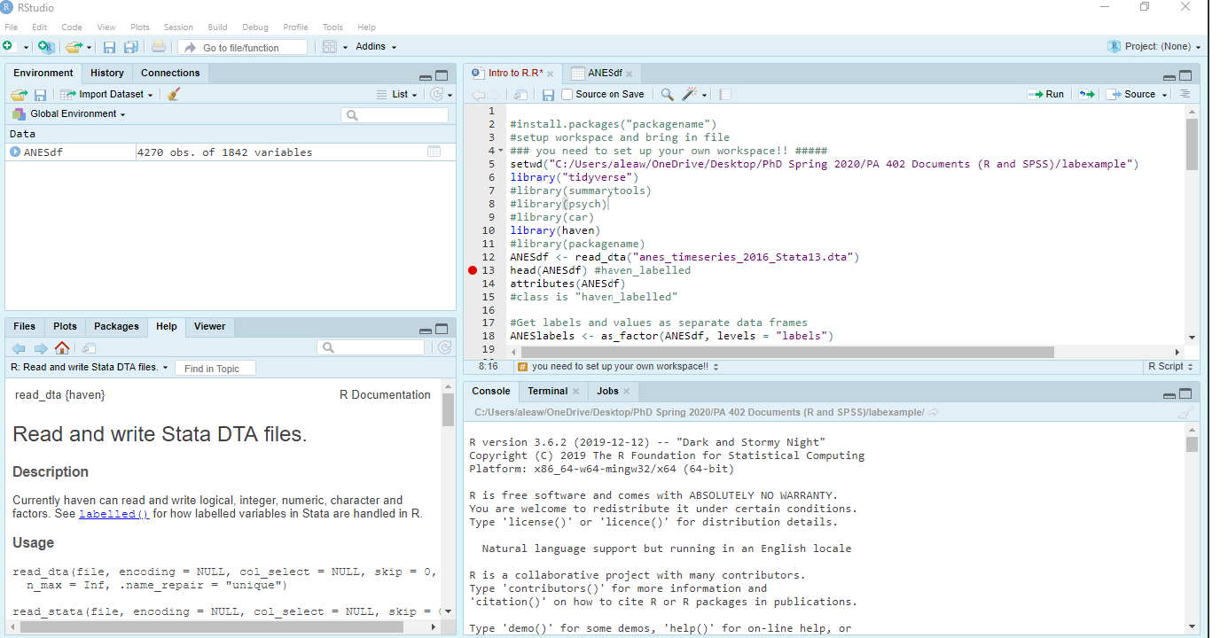
Environment / History
File Viewer / Editor
Files/Plots/etc.
Console
Notes:
Each time R is opened, a new “Session” starts. You can change the color scheme and layout in Tools > Global Options > Appearance or View > Pane Layout > Arrange the way you want.
The file viewer. Here you can write your code in a script file for safekeeping and reuse or look at your data in spreadsheet format. When you want to look at more than one file at a time, you can view them in a separate window.
The console. This is where you enter code and see the output. You can either type out your code here or highlight code in the file viewer and use a keyboard shortcut to have it automatically entered.
The environment viewer. This just shows you a list of all the objects that are currently in R’s environment..
Files/Plots/Packages/Help. Does a wide range of things and it is customizable.

Slide 6
PPOL 105: Intro to R

Slide 7
Installing R and RStudio
What you need:
http://www.cran.r-project.org/ ← Download R (Free version)
http://www.rstudio.com/download ← Download Rstudio (Free version)

Slide 8
Environment / History
File Viewer / Editor
Files/Plots/etc.
Console
Notes:
Each time R is opened, a new “Session” starts. You can change the color scheme and layout in Tools > Global Options > Appearance or View > Pane Layout > Arrange the way you want.
The file viewer. Here you can write your code in a script file for safekeeping and reuse or look at your data in spreadsheet format. When you want to look at more than one file at a time, you can view them in a separate window.
The console. This is where you enter code and see the output. You can either type out your code here or highlight code in the file viewer and use a keyboard shortcut to have it automatically entered.
The environment viewer. This just shows you a list of all the objects that are currently in R’s environment..
Files/Plots/Packages/Help. Does a wide range of things and it is customizable.

Slide 9
Open Datafile
Open file in R
Can use either File > Import > Select Data Type > Select Data File
Can type the command read_dta()
ANESdf <- read_dta("anes_timeseries_2016_Stata13.dta")
If the file is in your workspace
Otherwise, include the whole path to the file location, see below
ANESdf <-read_dta("C:\Users\username\Desktop\folder\PA402\anes_timeseries_2016_Stata13.dta")
Reads the .dta file and stores it as a new data frame in R, named ANESdf.
Name it something short but descriptive
Dataframe should now exist in the R Environment tab. Click it. What do you see?
Notes:
Mac users do not need the .dta extension at the end of the file name !!

Slide 10
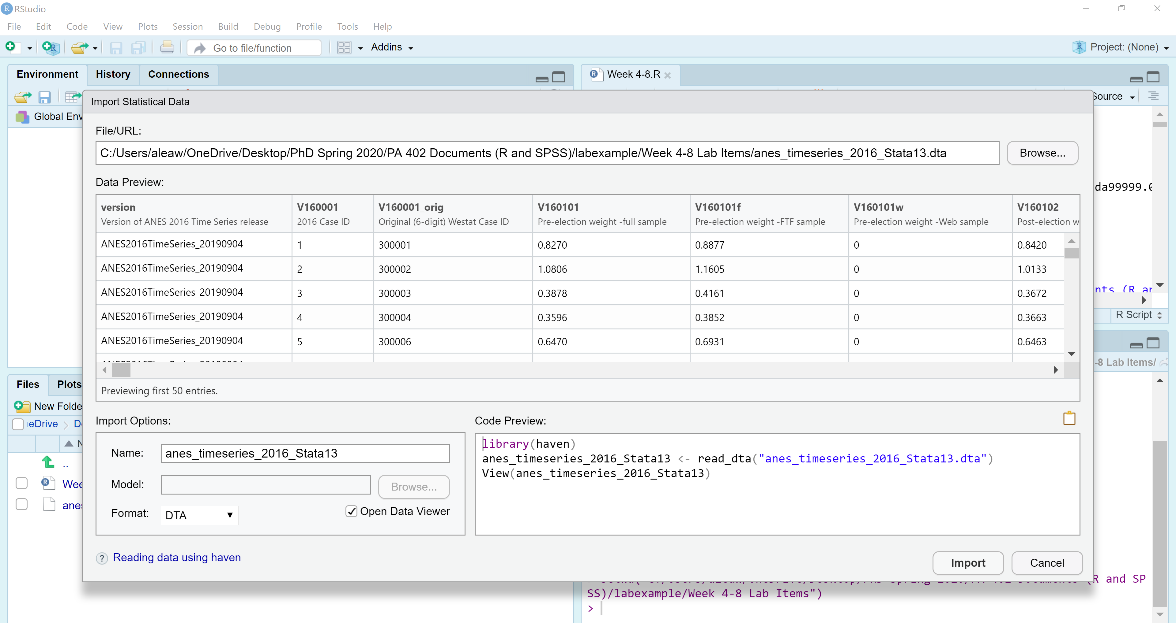
Notes:
File > Import > From Stata> Browse for file you want
You can rename it in this interface too in the “Import Options” area. I did not do that in this image.

Slide 11
Making RStudio Work: Install Packages
install.packages(“packagename”) #installs on computer- only need to do this once
library(“packagename”) # loads the package into your workspace
install.packages(“tidyverse”) #contains dplyr, ggplot, tibble, readr, tidyr, purr
install.packages(“haven”) #can read SPSS and Stata files.
library(“tidyverse”)
library(“haven”)
Notes:
Fogarty pg 17

Slide 12
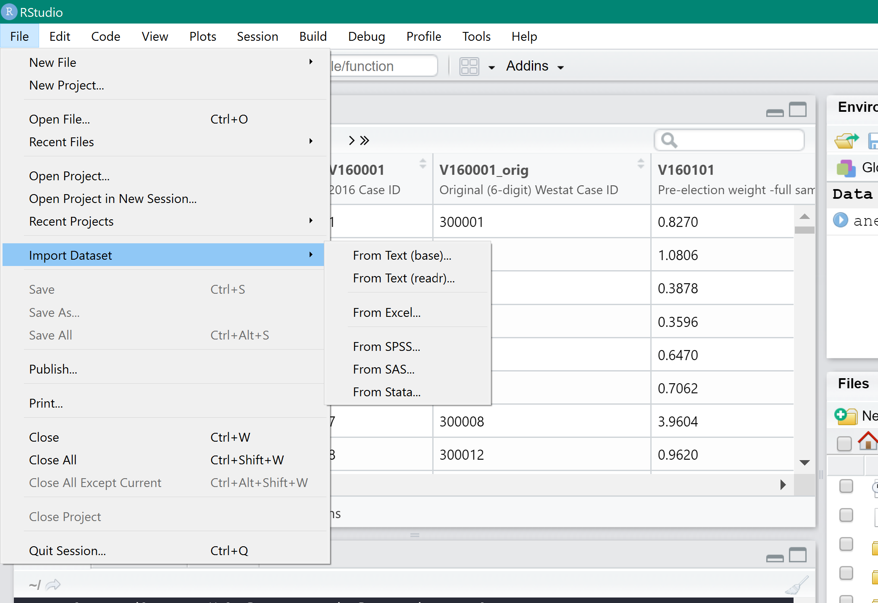
You can also use menus to important data files:
Can import multiple file types
.csv or .xlsx
.sas
.sav
Text
Or Open File → the file you want to use
Notes:
You can do this, but it doesn’t always work the way you want or only works for certain file types.

Slide 13
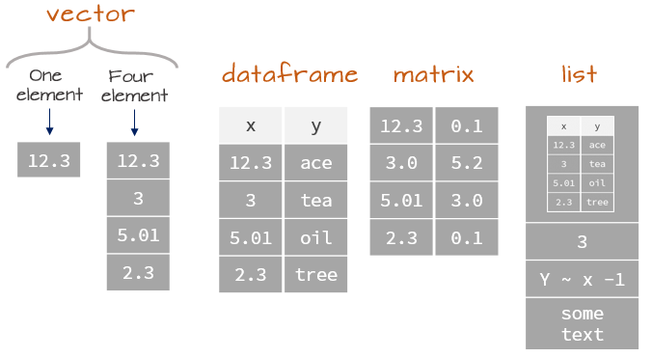
Types of Objects: Vectors, Matrices, and Data Frames
Vector = one-dimensional collection of data, can be a row OR column.
Data Frame = a type of matrix. Think of it like an excel file.
Matrix = combination of columns and rows. At least 1 of each.
Data sets are most often organized with variables in columns (ID number, age, evaluation of President’s performance, etc.) and unit of analysis (people, organizations, observations) in the rows.
Notes:
Vector = one-dimensional collection of data, can be a row OR column.
Matrix = combination of columns and rows. At least 1 of each.
Data Frame = a type of matrix. Think of it like an excel file.
Columns of a data frame are variables

Slide 14
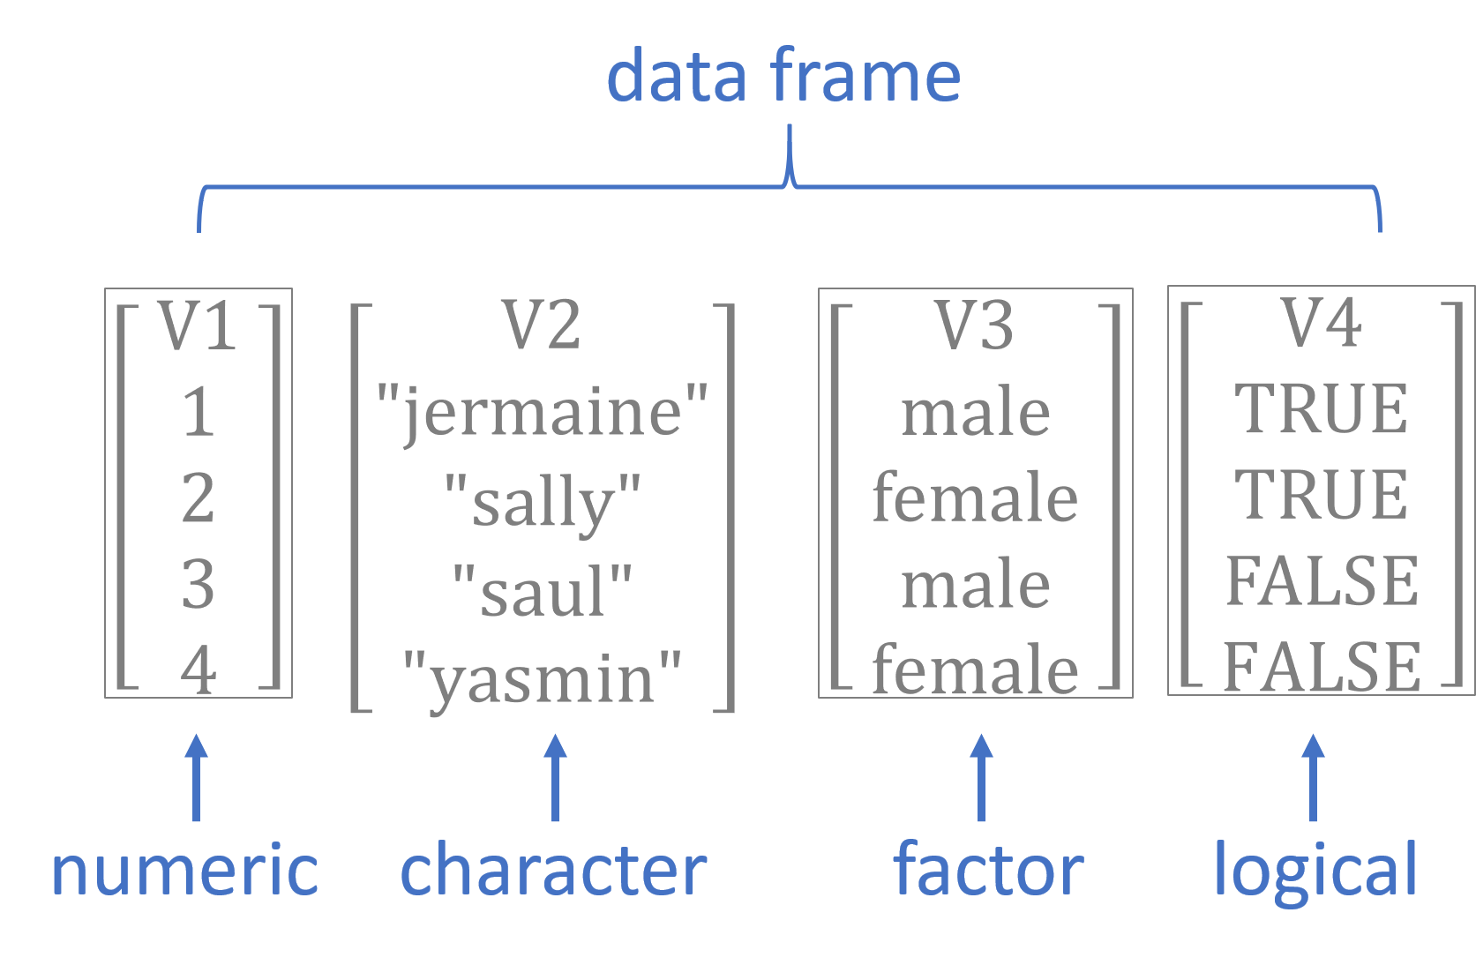
Types of Data & Levels of Measurement
Nominal = logical (binary), factor (categorical)
No Order (ex. race, religion, etc.). Numbers assigned don’t have actual meaning
Ordinal = numeric
has general sense of increasing or decreasing order, but the distances between categories aren’t meaningful
Ex. 1 = high school diploma, 2 = undergraduate degree, 3 = masters degree
Number of years to get each one are all different
Not a form of measurement
Notes:
Discussed more in Week 3

Slide 15
Levels of Measurement: Interval vs. Ratio
Interval = numeric
Has order, Distance between numbers has meaning, 0 is arbitrary
Ex. Temperature in C or F, feeling thermometer survey questions
Ratio = numeric
Same as interval, but 0 implies an attribute does not exist
Ex. Movement of 0 mph, salary of $0,
Not a form of measurement
Notes:
Week 3

Slide 16
Factors, Levels, Values, and Labels
dataframe$variable <- factor(dataframe$variable, levels = 1:5 , labels = c( 'Excellent' , 'Very Good' , 'Good' , 'Fair' , 'Poor’ ))
# levels = the number of options for each variable
Like a multiple choice test (A, B, C, D or 1,2, 3, 4)
# labels = the word that is glued to the value or level of each option for a variable
Describes the variable, levels, or values
# values = numbers that would be used for calculations
# factors = kind of like a paperclip holding together the variable, levels, labels, and values

Slide 17
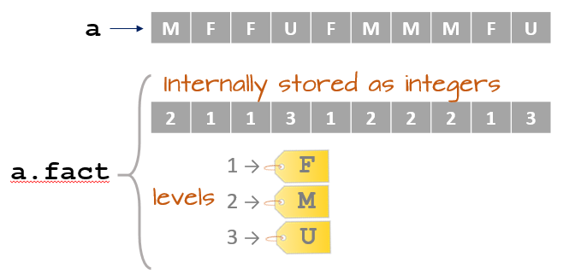
a is an object that is a vector, only contains one type of information. Either a word or a number.
a.fact is an object that is a factor, it contains multiple types of information for each variable
Factors have attributes where additional information is stored but hidden
Factors have attributes where additional information is stored but hidden.
Attributes can be labels, levels, values, and more ways of describing data in the data frame
https://mgimond.github.io/ES218/Week02a.html for an even more detail explanation with examples
Notes:
The vector, a, is a literally the letters “M”, “F”, and “U” stored as text. Can not do math with character data types.
When the vector is turned into a factor using the as.factor() command, the data type changes to an integer. Factors have multiple attributes which store information, but are hidden from the visible data frame. To view all the attributes of an object, use the attributes() command.
a.fact has two attributes: levels and class.
$levels stores the integer version, 1, 2, and 3 which is linked with the letters F, M, and U.
$class tells you that the object is a factor
https://mgimond.github.io/ES218/Week02a.html for an even more detail explanation with examples.

Slide 18
Open Datafile
Open file in R
Can use either File > Import > Select Data Type > Select Data File
Can type the command read_dta()
ANESdf <- read_dta("anes_timeseries_2016_Stata13.dta")
If the file is in your workspace
Otherwise, include the whole path to the file location, see below
ANESdf <-read_dta("C:\Users\username\Desktop\folder\PA402\anes_timeseries_2016_Stata13.dta")
Reads the .dta file and stores it as a new data frame in R, named ANESdf.
Name it something short but descriptive
Dataframe should now exist in the R Environment tab. Click it. What do you see?
Notes:
Mac users do not need the .dta extension at the end of the file name !!

Slide 19
Notes:
File > Import > From Stata> Browse for file you want
You can rename it in this interface too in the “Import Options” area. I did not do that in this image.

Slide 20
Making RStudio Work: Install Packages
install.packages(“packagename”) #installs on computer- only need to do this once
library(“packagename”) # loads the package into your workspace
install.packages(“tidyverse”) #contains dplyr, ggplot, tibble, readr, tidyr, purr
install.packages(“haven”) #can read SPSS and Stata files.
library(“tidyverse”)
library(“haven”)
Notes:
Fogarty pg 17

Slide 21
You can also use menus to important data files:
Can import multiple file types
.csv or .xlsx
.sas
.sav
Text
Or Open File → the file you want to use
Notes:
You can do this, but it doesn’t always work the way you want or only works for certain file types.

Slide 22
Types of Objects: Vectors, Matrices, and Data Frames
Vector = one-dimensional collection of data, can be a row OR column.
Data Frame = a type of matrix. Think of it like an excel file.
Matrix = combination of columns and rows. At least 1 of each.
Data sets are most often organized with variables in columns (ID number, age, evaluation of President’s performance, etc.) and unit of analysis (people, organizations, observations) in the rows.
Notes:
Vector = one-dimensional collection of data, can be a row OR column.
Matrix = combination of columns and rows. At least 1 of each.
Data Frame = a type of matrix. Think of it like an excel file.
Columns of a data frame are variables

Slide 23
Types of Data & Levels of Measurement
Nominal = logical (binary), factor (categorical)
No Order (ex. race, religion, etc.). Numbers assigned don’t have actual meaning
Ordinal = numeric
has general sense of increasing or decreasing order, but the distances between categories aren’t meaningful
Ex. 1 = high school diploma, 2 = undergraduate degree, 3 = masters degree
Number of years to get each one are all different
Not a form of measurement
Notes:
Discussed more in Week 3

Slide 24
Levels of Measurement: Interval vs. Ratio
Interval = numeric
Has order, Distance between numbers has meaning, 0 is arbitrary
Ex. Temperature in C or F, feeling thermometer survey questions
Ratio = numeric
Same as interval, but 0 implies an attribute does not exist
Ex. Movement of 0 mph, salary of $0,
Not a form of measurement
Notes:
Week 3

Slide 25
Factors, Levels, Values, and Labels
dataframe$variable <- factor(dataframe$variable, levels = 1:5 , labels = c( 'Excellent' , 'Very Good' , 'Good' , 'Fair' , 'Poor’ ))
# levels = the number of options for each variable
Like a multiple choice test (A, B, C, D or 1,2, 3, 4)
# labels = the word that is glued to the value or level of each option for a variable
Describes the variable, levels, or values
# values = numbers that would be used for calculations
# factors = kind of like a paperclip holding together the variable, levels, labels, and values

Slide 26
a is an object that is a vector, only contains one type of information. Either a word or a number.
a.fact is an object that is a factor, it contains multiple types of information for each variable
Factors have attributes where additional information is stored but hidden
Factors have attributes where additional information is stored but hidden.
Attributes can be labels, levels, values, and more ways of describing data in the data frame
https://mgimond.github.io/ES218/Week02a.html for an even more detail explanation with examples
Notes:
The vector, a, is a literally the letters “M”, “F”, and “U” stored as text. Can not do math with character data types.
When the vector is turned into a factor using the as.factor() command, the data type changes to an integer. Factors have multiple attributes which store information, but are hidden from the visible data frame. To view all the attributes of an object, use the attributes() command.
a.fact has two attributes: levels and class.
$levels stores the integer version, 1, 2, and 3 which is linked with the letters F, M, and U.
$class tells you that the object is a factor
https://mgimond.github.io/ES218/Week02a.html for an even more detail explanation with examples.

Slide 27
dplyr
Notes:
In last week’s lab, you learned to:
Open R, RStudio and data file.
Structure of R, Rstudio
Install packages.
This week, you will learn how to recode variables into new variables:
Recode missing values when needed.
Run frequencies of variables

Slide 28
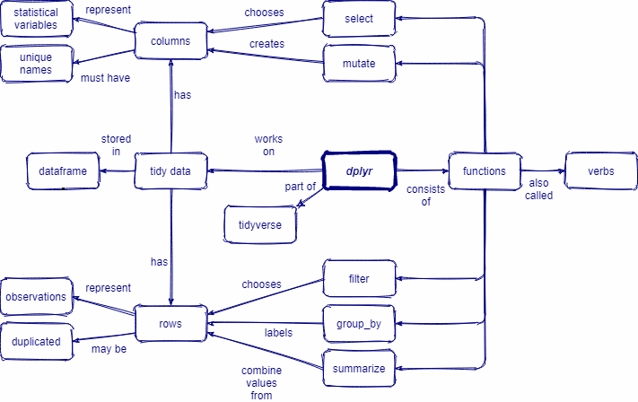

Slide 29
Slides below were originally done using $ coding. Remake with dplyr() code
Keep general ideas but redo.

Slide 30
Useful Functions and Packages
filter() to select cases based on their values.
arrange() to reorder the cases.
select() and rename() to select variables based on their names.
mutate() and transmute() to add new variables that are functions of existing variables.
summarize() to condense multiple values to a single value.

Slide 31
Create a Smaller Dataset: Subset Data
Notice there are 4270 variables in the ANES dataset
You probably don’t need them all.
Keep specific variables
> dataframenew <- subset(dataframeold, select = c(variable1, variable2, variable7:12)
Delete specific variables:
> dataframenew <- subset(dataframeold, select = - c(variable1, variable2, variable7:12)
# deletes variable1, variable2, and variable 7 through 12
Make our dataset smaller: ANES <- subset(ANES, select=-c(V161363a:V168528))
# deletes a bunch of variables/columns listed in the codebook that aren’t main variables
Notes:
Should have 570 variables left
Change to select () in tidyverse

Slide 32
Defining Missing Values = NA in R
Respondents who said “I don’t know” or refused to answer
Respondents who weren’t asked the question (e.g., men for questions about pregnancy)
Often, these responses are given numeric codes that separate them from the substantive values (-9, 99, etc.)
Avoid accidentally including them in analysis!
Numbers typically don’t have actual meaning
They will mess up your calculations unless you change them so that the program recognizes them as “missing” data

Slide 33
Recoding a Categorical Variable
#****gender*****
class(ANES$V161342)
table(ANES$V161342)
ANES$gender <- recode(ANES$V161342, "1='0.Male';2='1.Female'; else=NA")
attr(ANES$gender, "value") <- abs((1-as.numeric(ANES$gender))) #is numeric
table(ANES$gender)
attributes(ANES$gender)
Notes:
Categorical variable: You either are something or you are not something. Mathematical averages do not make sense. Frequently coded as dummy variables.

Slide 34
Descriptive Statistics in R
Notes:
In last week’s lab, you learned to:
Open R, RStudio and data file.
Structure of R, Rstudio
Install packages.
This week, you will learn how to recode variables into new variables:
Recode missing values when needed.
Run frequencies of variables

Slide 35
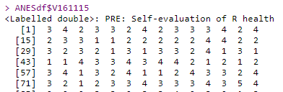

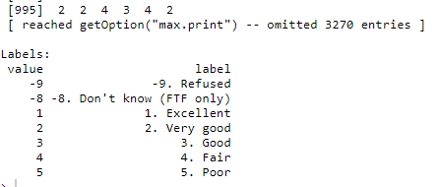
Look at a Variable: V161115
> ANESdf$V161115 #type in Console
Get output for that variable.
Shows first 1000 observations and information on labels.
Tells R which dataset to use
Tells R which variable you want
Notes:
Unlike other statistics programs, R can use multiple datasets in one analysis. However you need to tell it which dataset to use when you are working with variables. When referencing a variable, you must use the format of dataframe$variable so that R knows what you want. This is another reason to label your variable with short, but useful names.

Slide 36
Each time R is opened, a new “Session” starts
The file viewer. Here you can write your code in a script file for safekeeping and reuse or look at your data in spreadsheet format. When you want to look at more than one file at a time, you can view them in a separate window.
The console. This is where you enter code and see the output. You can either type out your code here or highlight code in the file viewer and use a keyboard shortcut to have it automatically entered.
The environment viewer. This shows you a list of all the objects that are currently in R’s environment. Data frames, objects, factors, anything you create or import
Files/Plots/Packages/Help. Does a wide range of things and it is customizable.

Slide 37
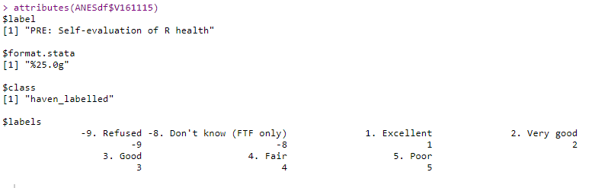
Attributes: V161115
# type in Console or project file
> attributes(ANESdf$V161115)
$label = label of the question. “Pre” means the question was asked before the election.
$class = haven was the program used to read in the data. Creates a temporary class that allows you to turn it into a more useful “factor.” Normally would want it to say “factor” or “numeric” for an analysis
$labels = description of the variable. Combined information from datafile for numeric values and text descriptions
Notes:
Has attributes: $value (with just numbers), $label (character data type that describes what the question was), $class (tells you how information is bundled together for the variable and what you can do with the variable)

Slide 38
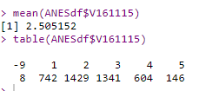
Frequencies: V161115
> table(ANESdf$V161115)
Shows frequency of observations for each coded option
742 selected the option that was coded 1
8 people were coded as -9.
> mean(ANESdf$V161115)
R sometimes knows to use the numeric part of the label
There are better ways of data management
Is this useful? Does it tell you anything?
Only if you look at the Codebook!
Top row is potential responses coded as an integer.
Bottom row is number of people who selected each potential response.
Notes:
Unlike other statistics programs, R can use multiple datasets in one analysis. However you need to tell it which dataset to use when you are working with variables. When referencing a variable, you must use the format of dataframe$variable so that R knows what you want. This is another reason to label your variable with short, but useful names.
Has attributes: value (with just numbers), label ()

Slide 39
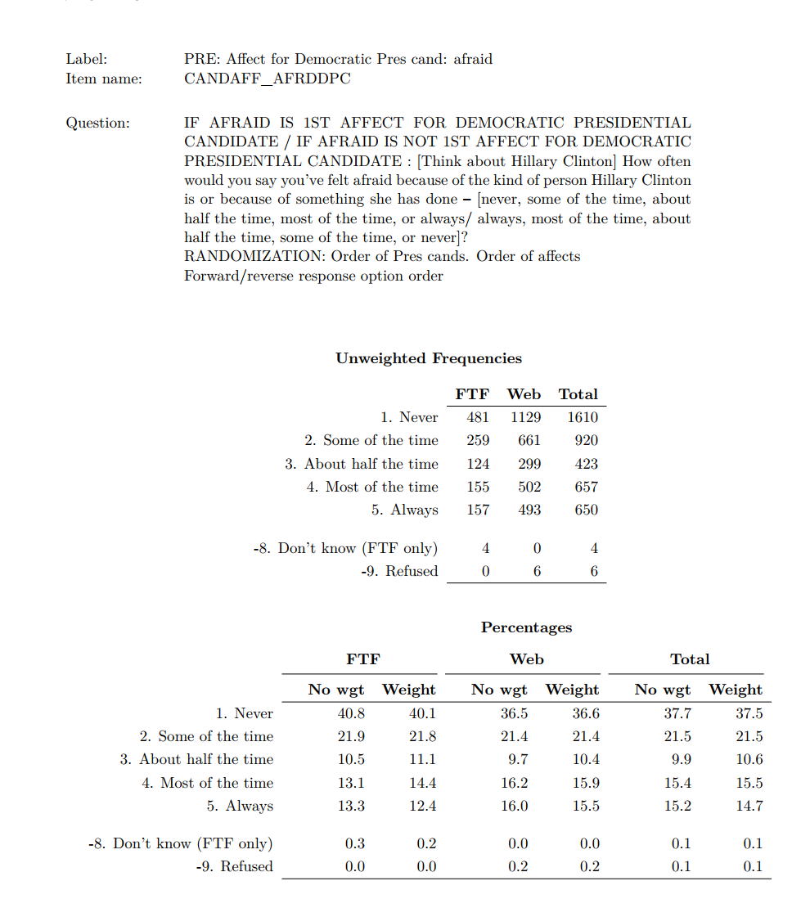
Example from a codebook:
In this case, you would want to recode -8 and -9 as missing values
When you import a file (depending on the file type), it prompts you with an NA blank box
You can enter the values that you want to become “missing” for entire dataset
This is not always an option
Messy data, different file types, etc.
Can also do with code commands
Notes:
There are a lot of ways to deal with missing values. If in doubt, Google it out.

Slide 40
Which responses are coded as missing for V161115?
How else can you figure out if there are missing values for different variables?
THE CODEBOOK! --> V161115 says that -9 is for “Refused” aka Missing
Scroll through the data.frame in the Viewer
Click on View> Show Viewer if it isn’t already open
Do you see 0’s, negative numbers, weirdly large numbers, or NA’s?
If you see NA’s, that is good!
If you see 99, -9, -8, etc., these need to be coded as missing
Notes:
Lets say you don’t have perfectly cleaned data designed to be used in R and you need to know if R recognizes that there is data coded as missing.
V161115 has -9 for refused answers.

Slide 41
Reverse Coding and Change Scale
Reverse direction to be more sensible, “lowest” value = 0
Want:
Poor = 0
Fair = 1
Good = 2
Very Good = 3
Excellent = 4
Absolute value of (1 – variable options)
|1-5| = 4 = Excellent
|1-4| = 3
|1-3| = 2
|1-2| = 1
|1-1| = 0 = Poor
Reversed direction and change scale to range from 0 to 1
Poor = 0/4 = 0
Fair = 1/4 = .25
Good = 2/4 = .50
Very Good = 3/4 = .75
Excellent = 4/4 = 1
R code would be:
usefulVariable <- abs((1-numericVariable)/4)
Notes:
Healthy <- (5-V161115)/5
You can use recode() directly with factors; it will preserve the existing order of levels while changing the values.

Slide 42
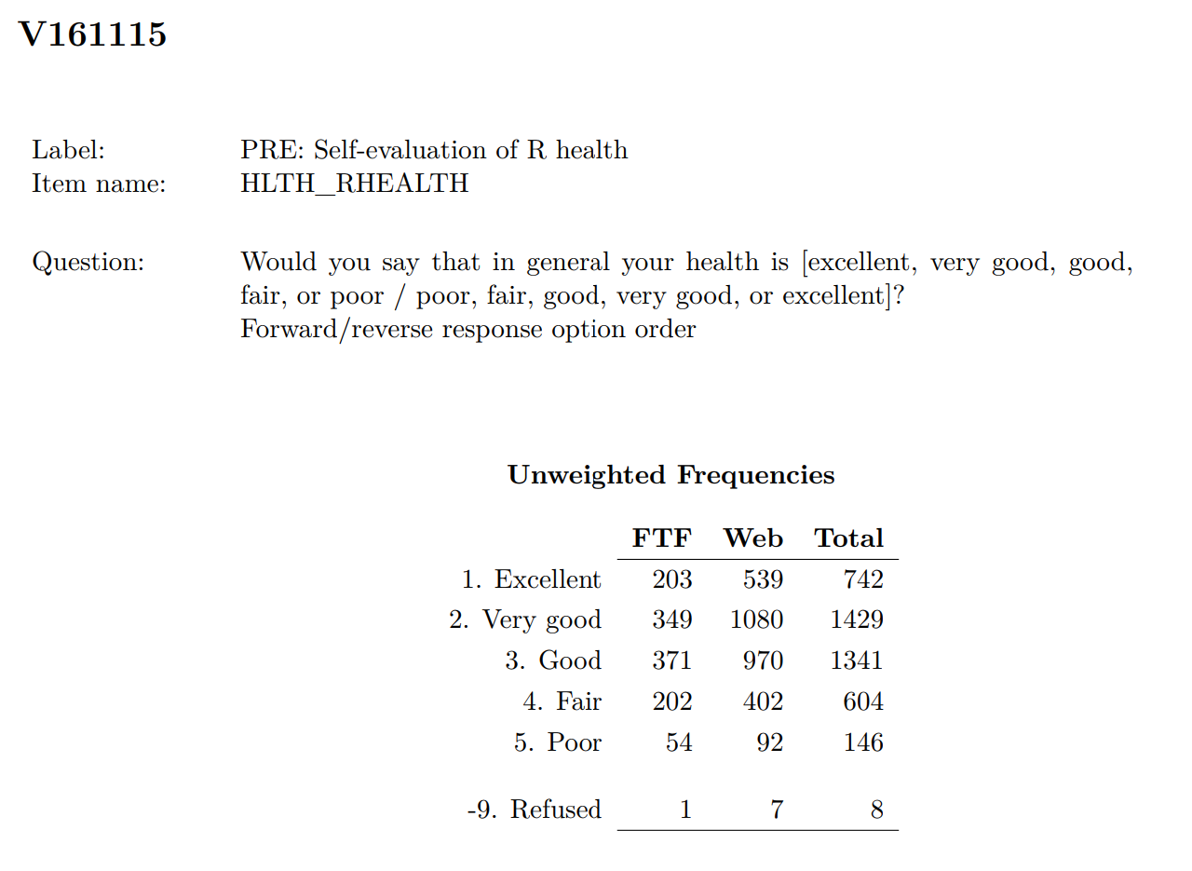
What’s the problem with this coding?
It has “refused” coded as -9
-9 → NA
Responses are 1- 5
Want 0-1 for analysis
Want scores to be from “low” to “high”
Flip order of responses
Should end up with a scale of Poor (0) to Excellent (1)
Notes:
It has “refused” coded as -9
-9 → NA
Responses are 1- 5
Want 0-1 for analysis
Want scores to be from “low” to “high”
Flip order of responses
Should end up with a scale of Poor (0) to Excellent (1)

Slide 43
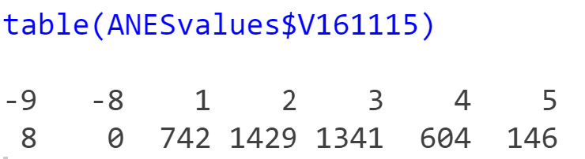
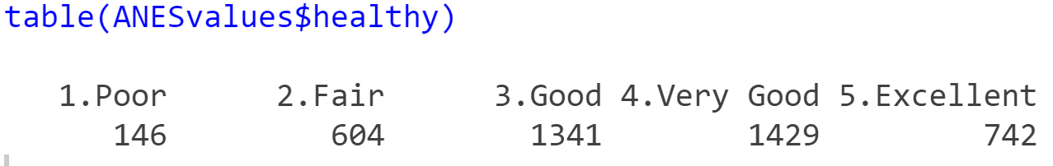
Fixing V161115: Aesthetics
# Run variable frequency
> table(ANESvalues$V161115)
#without labels
> ANESvalues$healthy <- recode(ANESvalues$V161115, "5='1.Poor';4='2.Fair';3='3.Good';2='4.Very Good';1='5.Excellent';else=NA")
#recode from low to high
# -8 and -9 recoded as NA

Slide 44
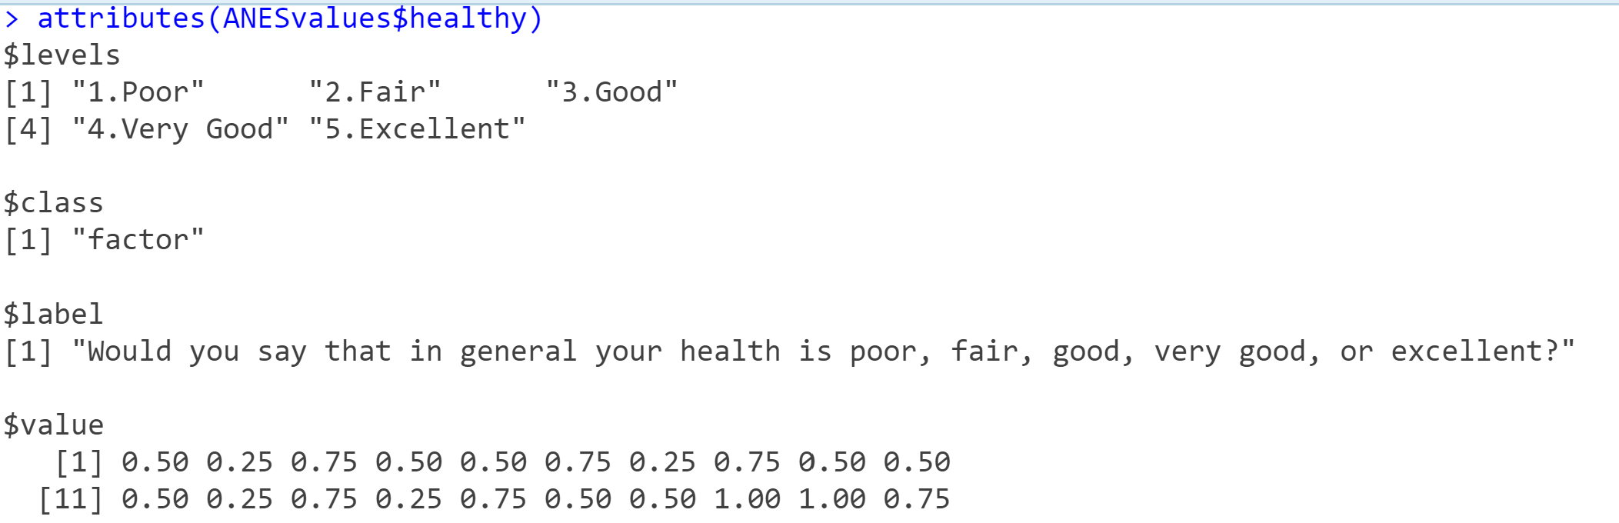
Fixing V161115: New Scale
> attr(ANESvalues$healthy, "value") <- abs((1-as.numeric(ANESvalues$healthy))/4)
# is numeric; allows mathematical calculations.
# Now it is on scale from 0 to 1 for analysis
Notes:
Usage
na_if(x, y)
Arguments
X Vector to modify
Y Value to replace with NA

Slide 45
Creating Indices
Measurement, Types of Variables, Indices, and Reliability
Notes:
In last week’s lab, you learned to:
Open R, RStudio and data file.
Structure of R, Rstudio
Install packages.
Recode missing values when needed.
Run frequencies of variables
This week, you will learn to
Creat a multi-item scale
Recode them to the same scale
Test alpha coefficient
Combine into an index
Validity
Reliability

Slide 46
Example Index in R: Racial Resentment (ANES 2016)
V152211: Irish, Italians, Jewish and many other minorities overcame prejudice and worked their way up. Blacks should do the same without any special favors.
V162212: Generations of slavery and discrimination have created conditions that make it difficult for blacks to work their way out of the lower class.
V162213: Over the past few years, blacks have gotten less than they deserve.
V162214: It’s really a matter of some people not trying hard enough, if blacks would only try harder they could be just as well off as whites.
All are Likert scales that go from Agree Strongly → Disagree Strongly
BUT do they actually capture positive or negative sentiment?

Slide 47
Scales: Direction Matters!
V162211: Irish, Italians, Jewish and many other minorities overcame prejudice and worked their way up. Blacks should do the same without any special favors.
Strongly Agree = most racist
V162212: Generations of slavery and discrimination have created conditions that make it difficult for blacks to work their way out of the lower class.
Strongly Agree = least racist
V162213: Over the past few years, blacks have gotten less than they deserve.
Strongly agree = least racist
V162214: It’s really a matter of some people not trying hard enough, if blacks would only try harder they could be just as well off as whites.
Strongly Agree = most racist
If you were to combine the observations as they are coded, what would happen?
Notes:
Answer, you’d get a mathematical answer, but any interpretation would not be valid because you have two variables going from least racist -> most racist and two variables going from most racist -> least racist.
V162211 and V162214 need to be flipped in order to make an index of racial resentment!

Slide 48
Reverse Recoding
If you were trying to capture racial resentment with these variables, they must be coded so that the underlying construct is measured in the same direction.
Either flip direction of V162211 & V162214 OR flip V162212 & V162213.
Depending on which variables are recoded, the construct of racial resentment goes from:
most racist → least racist
OR
least racist → most racist.
JUST BE CONSISTENT AND KNOW WHICH DIRECTION YOU CHOSE!

Slide 49
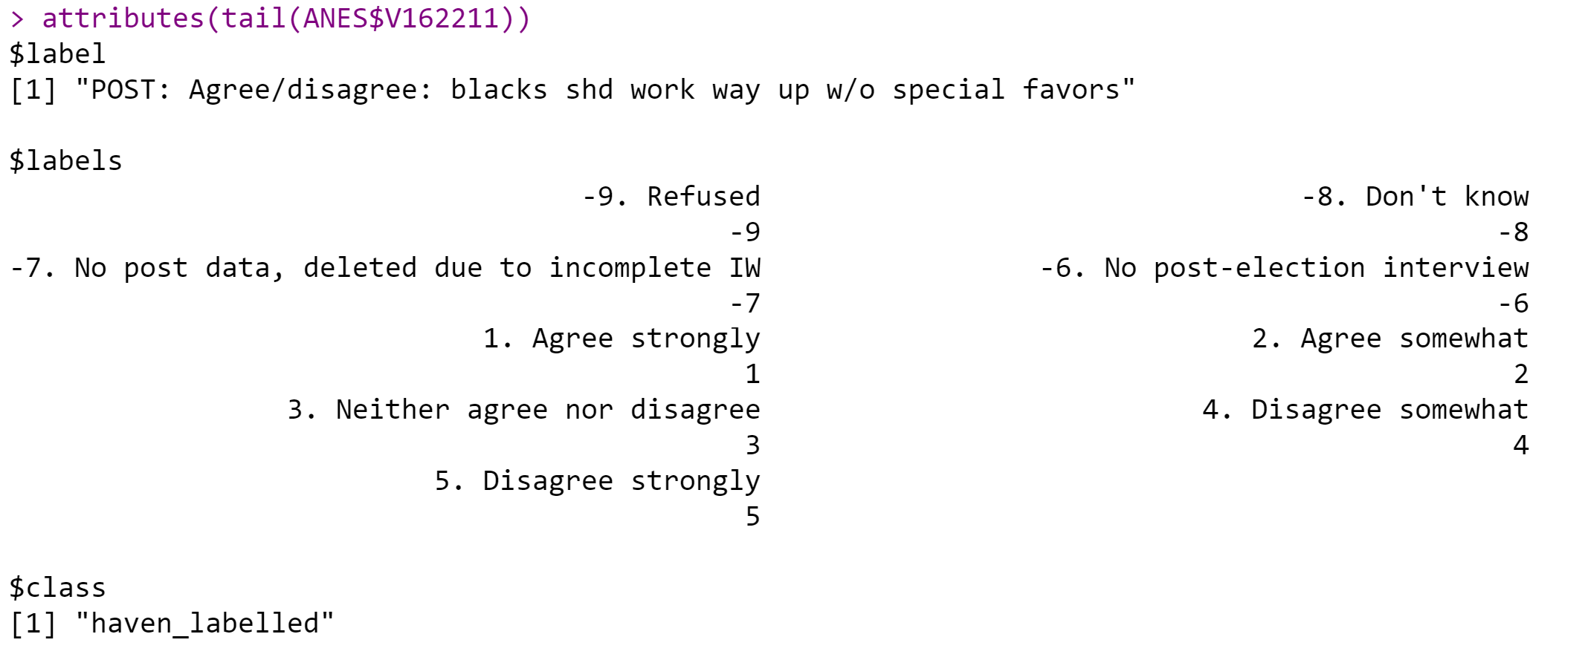
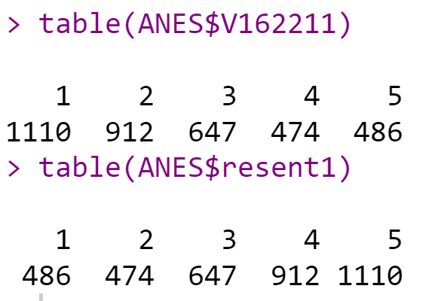
V162211: Irish, Italians, Jewish and many other minorities overcame prejudice and worked their way up. Blacks should do the same without any special favors. => Strongly Agree = most racist
> ANES$resent1 <- recode(ANES$V162211, "5=1; 4=2;3=3;2=4;1=5")
R has already taken care of the missing values – they don’t show up in the table
Make sure values match! Originally, “1. Agree Strongly” had 1110 people select it. It has to match the 5th level that represents higher levels of racial resentment. Check other levels too!
Notes:
# Don't need to label everything when making an index
# You do need to know the direction of coding and its meaning for each variable. Some go high->low, some go low-> high.
### **** Racial Resentment Correlation and Index Creation **** ###
table(ANES$V162211)
# You do need to know the direction of coding and its meaning for each variable. Some go high->low, some go low-> high.
ANES$resent1 <- recode(as.numeric(ANES$V162211), "5=1; 4=2;3=3;2=4;1=5")
#Think of the format this way: What you have = what you want.
table(ANES$resent1)
table(ANES$V162212)
ANES$resent2 <- ANES$V162212
ANES$resent3 <- ANES$V162213
ANES$resent4 <- recode(as.numeric(ANES$V162214),"5=1; 4=2;3=3;2=4;1=5")
table(ANES$resent4)

Slide 50
Another way to recode ANES$resent1 that has labels
# Still format of "Have=Want“ when recoding variables
> table(ANES$V162211)
> ANES$resent1OPTION2 <- recode(as.numeric(ANES$V162211), "1='5.Strongly Disagree';2='4.Disagree';3='3.Neither Agree/Disagree';4='2.Agree';5='1.Strongly Agree’”)
> table(ANES$resent1OPTION2)

Slide 51
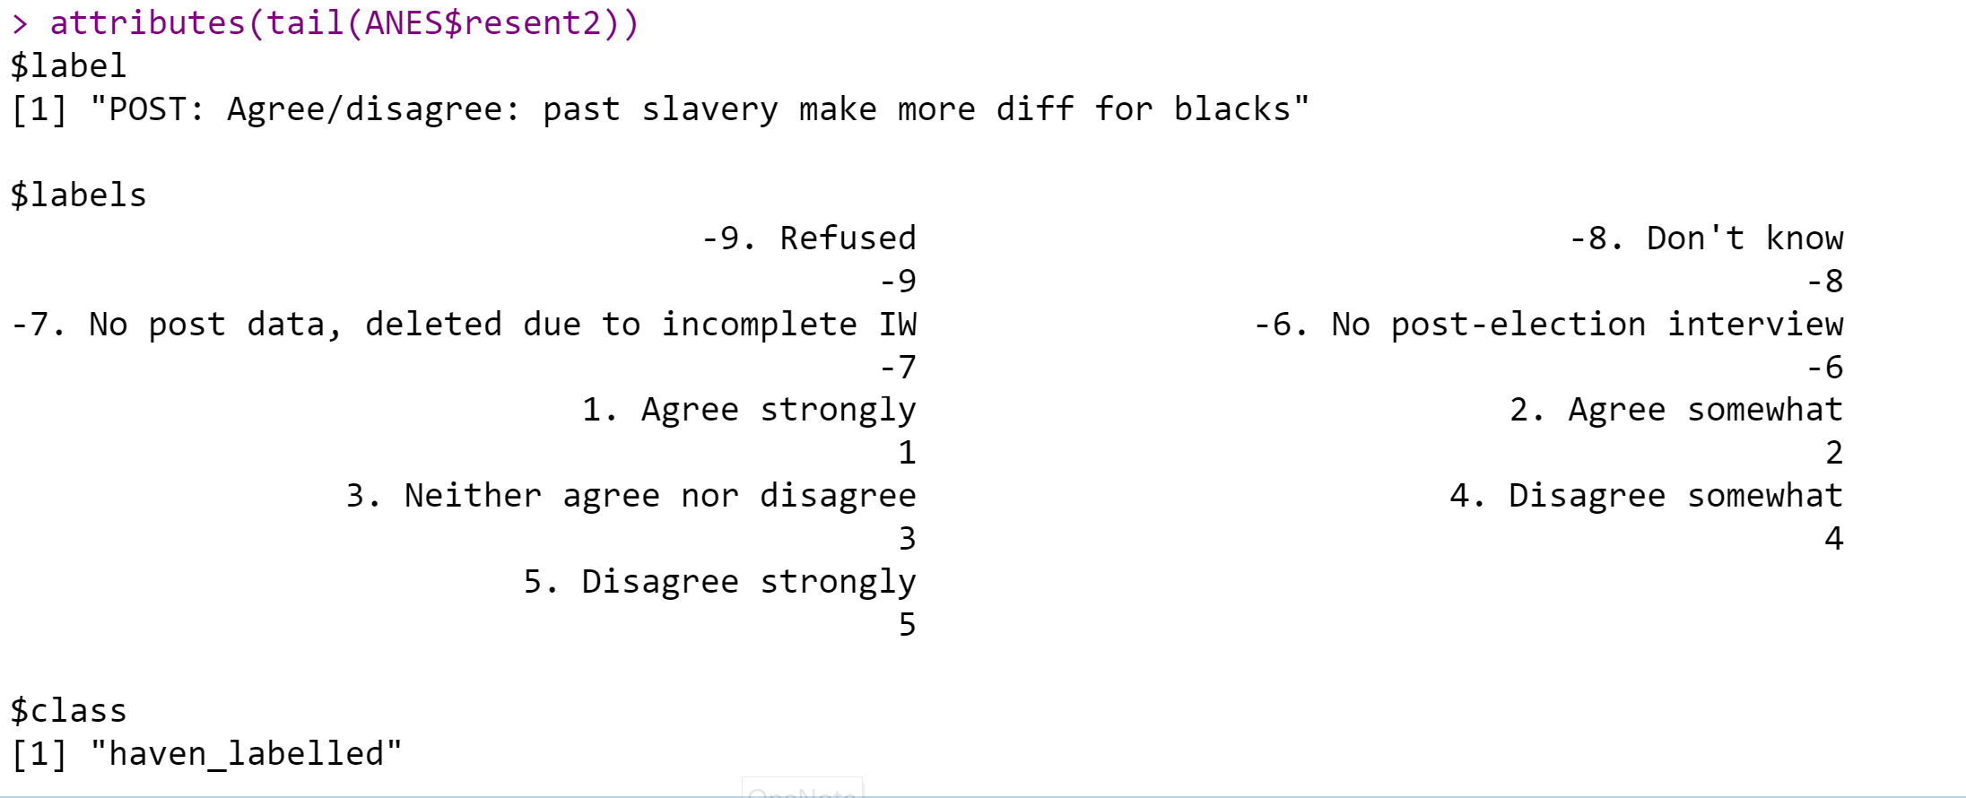
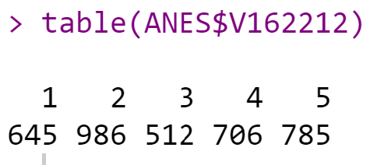
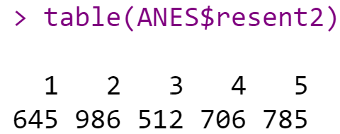
V162212: Generations of slavery and discrimination have created conditions that make it difficult for blacks to work their way out of the lower class. => Strongly Agree = least racist
> table(ANES$V162212)
# Note that missing values are taken care of already in table()
> ANES$resent2 <- ANES$V162212
# yes, it is that easy
> table(ANES$resent2)
Make sure values match! Originally, “1. Agree Strongly” had 645 people select it. We didn’t reverse this one, so it is correct.
Notes:
table(ANES$V162212)
# Note that missing values are taken care of already in table()
ANES$resent2 <- ANES$V162212
# yes, it is that easy.
table(ANES$resent2)

Slide 52
Example Index: Racial Resentment Variables
# Look at codebook to determine direction of scales for underlying construct
# Don't need to label everything when making an index
ANES$resent1 <- recode(as.numeric(ANES$V162211), "5=1; 4=2;3=3;2=4;1=5")
ANES$resent2 <- ANES$V162212
ANES$resent3 <- ANES$V162213
ANES$resent4 <- recode(as.numeric(ANES$V162214),"5=1; 4=2;3=3;2=4;1=5")
# check your work to make sure the counts still match those of the codebook.
Notes:
More than one way to label things!

Slide 53
Cronbach alpha reliability test
Cronbach’s alpha is a measure of internal consistency and scale reliability.
Higher values show better scale reliability.
Usually, α > .70 is acceptable.
Before using an index for racial resentment, check the correlation between the variables in the index
> library(psych)
> someindex <- subset(dataframe, select=c(rangeOf:variablesYouWant)) # creates index / mini df
> alpha(someindex) # estimate of reliability for a single scale

Slide 54
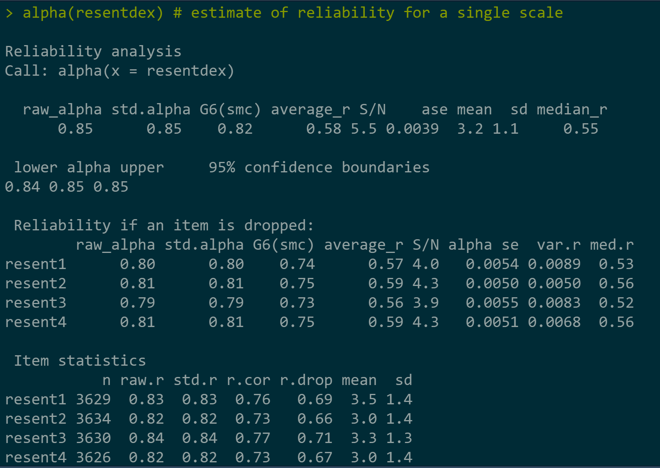
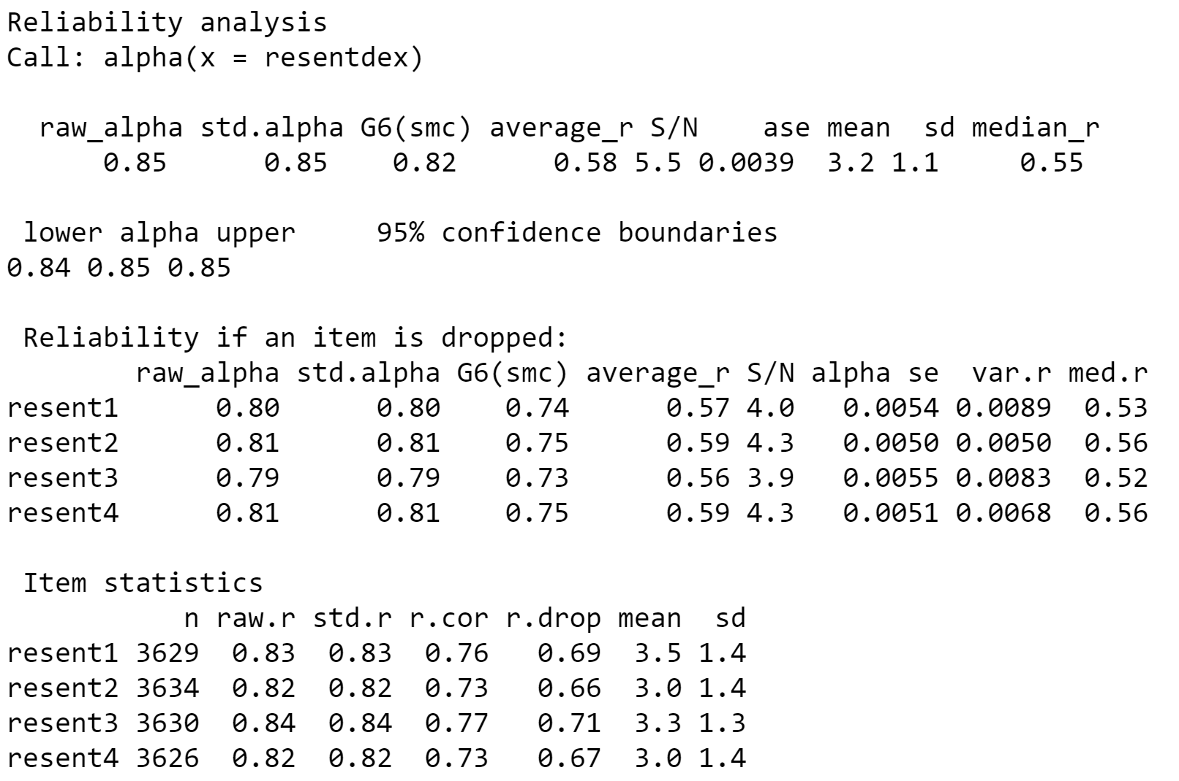
Raw_alpha is what we care about
None of the alphas increase when a variable is dropped. Therefore keep the variables.
Notes:
What do the summary statistics mean?
raw_alpha: Cronbach’s α (values ≥ .7 or .8 indicate good reliability; Kline (1999))
std.alpha: this should be similar to raw_alpha (we only need the raw alpha though)
G6: Guttman’s lambda 6 (calculated from the squared multiple correlation or ‘smc’)
average_r: average inter-item correlation (this is used to calculate std.alpha)
mean: scale mean (the mean of the means of all individuals)
sd: scale sd
How to interpret ‘Reliability if an item is dropped’?
The overall α (raw_alpha) is .85. Each row refers to each item and has a raw alpha associated—this refers to the overall α when that particular item has been dropped/deleted. For example, the first row refers to resent1, and if it is dropped, the overall α becomes .80, which reflects worse reliability, so we want to keep resent1.
We are checking whether any of these raw alpha values are greater than the overall α of .85; if yes, this means that dropping that particular item will increase the overall α of the scale.
The other columns of this table refer to how the other statistics will change if that particular item has been dropped/deleted.
How to interpret ‘Item statistics’?
raw.r: correlation between the item and the total score from the scale (i.e., item-total correlations); there is a problem with raw.r:, the item itself is included in the total—this means we’re correlating the item with itself, so of course it will correlate (r.cor and r.drop solve this problem)
r.drop: item-total correlation without that item itself (i.e., item-rest correlation or corrected item-total correlation); low item-total correlations indicate that that item doesn’t correlate well with the scale overall
r.cor: item-total correlation corrected for item overlap and scale reliability
mean and sd: mean and sd of the scale if that item is dropped
All items should correlate with the total score, so we’re looking for items that don’t correlate with the overall score from the scale. If r.drop values are less than about .3, it means that particular item doesn’t correlate very well with the scale overall.
How to interpret the final frequency table?
This table tells us what percentage of people gave each response to each of the items (i.e., if you have a 5-point scale, then it tells you how many percent of responses were 1, 2, 3, 4, or 5).
This helps you check the distribution of responses and whether everyone is giving the same responses (which will lead to low reliability).

Slide 55
Options if alpha coefficient is small:
1. Drop item(s) if that improves alpha to acceptable levels.
2. Look for other items to include in index to improve.
3. Consider as separate measures (not of the same underlying construct).
4. Combine them into an index and report it, even if it less than 0.7.

Slide 56
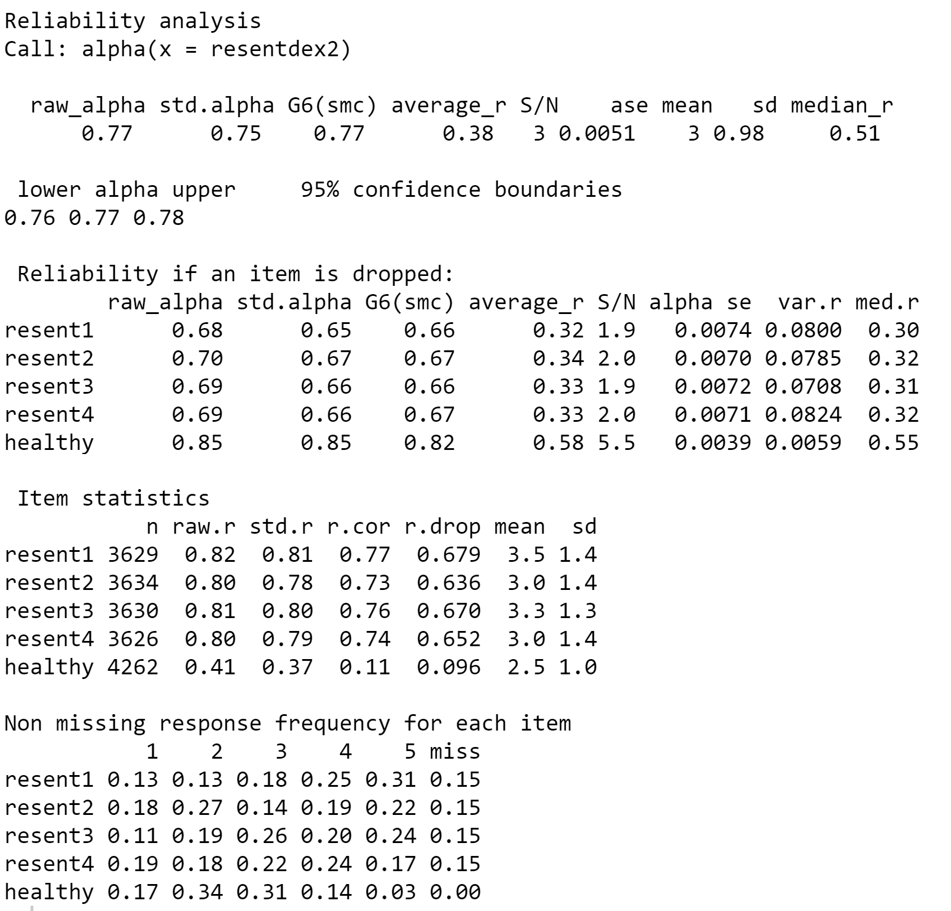
Raw alpha is what we care about
> resentment2 <- subset(ANES, select=c(resent1, resent2, resent3, resent4, healthy))
If the “healthy” variable is dropped, the alpha coefficient increases to 0.85.
This implies that “healthy” doesn’t measure the same construct as the other variables.
Notes:
Slide shows what happens if a variable that doesn’t fit into the construct is added into the index. Perceptions of health do not logically tap into the same construct as racist beliefs.
How to interpret ‘Reliability if an item is dropped’?
The overall α (raw_alpha) is .77 for the “resent” variables with the healthy variable. Each row refers to each item and has a raw alpha associated—this refers to the overall α when that particular item has been dropped/deleted. For example, the first row refers to resent1, and if it is dropped, the overall α becomes .68, which reflects worse reliability, so we want to keep resent1.
We are checking whether any of these raw alpha values are greater than the overall α of .77; if yes, this means that dropping that particular item will increase the overall α of the scale.
The other columns of this table refer to how the other statistics will change if that particular item has been dropped/deleted.

Slide 57
Lab Activity: Government Trust
We want to create an index to measure the level of trust in government How would you recode each of those so that higher numbers indicated greater trust?
Use V161215, V161217, V161218, V161219
2. Use alpha reliability coefficient approach to test whether those items can be combined into an index. Does dropping any of the items improve the alpha coefficient?
3. Create an index using the variables.
Notes:
Think about why it is possible to still have a low construct validity even if you find a large alpha coefficient.
Hint to find variables quickly in codebook:
CTRL+F for variable name

Slide 58
Government Trust Index
V161215: How often can you trust the federal government in Washington to do what is right?
V161217: Do you think that people in government waste a lot of the money we pay in taxes, waste some of it, or don’t waste very much of it?
V161218: How many of the people running the government are corrupt?
V161219: Generally speaking, how often can you trust other people?
Notes:
Low Levels of Trust -> High levels of trust.
Do any variables need to be reverse coded?

Slide 59
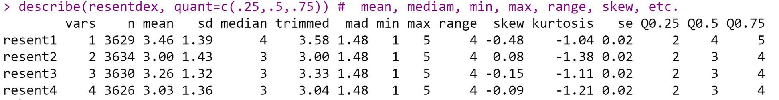
How to obtain descriptive statistics
describe() reports means, standard deviations, medians, min, max, range, skew, kurtosis and standard errors for integer or real data.
Non-numeric data, although the statistics are meaningless, will be treated as if numeric (based upon the categorical coding of the data)
Just because you can do math with the data, doesn’t mean you should
Notes:
x
A data frame or matrix
na.rm
The default is to delete missing data. na.rm=FALSE will delete the case.
interp
Should the median be standard or interpolated
skew
Should the skew and kurtosis be calculated?
ranges
Should the range be calculated?
trim
trim=.1 – trim means by dropping the top and bottom trim fraction
type
Which estimate of skew and kurtosis should be used? (See details.)
check
Should we check for non-numeric variables? Slower but helpful.
fast
if TRUE, will do n, means, sds, min, max, ranges for an improvement in speed. If NULL, will switch to fast mode for large (ncol * nrow > 10^7) problems, otherwise defaults to fast = FALSE
quant
if not NULL, will find the specified quantiles (e.g. quant=c(.25,.75) will find the 25th and 75th percentiles)
IQR
If TRUE, show the interquartile range
omit
Do not convert non-numerical variables to numeric, omit them instead
head
show the first 1:head cases for each variable in describeData
tail
Show the last nobs-tail cases for each variable in describeData

Slide 60
Recoding Variables
Create dichotomous variables, ordinal variables, groups

Slide 61
Create a Binary Variable from Categorical
We want to create a binary variable that equals 1 if the respondent believes women should never be able to obtain an abortion, and 0 otherwise (coding categories 5, -8, and -9 as NA).
> attributes(tail(ANES$V161232))
$label
[1] "PRE: STD Abortion: self-placement"
$labels
-9. Refused
-8. Don't know (FTF only)
1. By law, abortion should never be permitted.
2. By law, only in case of rape, incest, or woman's life in danger.
3. By law, for reasons other than rape, incest, or woman's life in danger if need established
4. By law, abortion as a matter of personal choice.
5. Other SPECIFY
$class
[1] "haven_labelled"

Slide 62
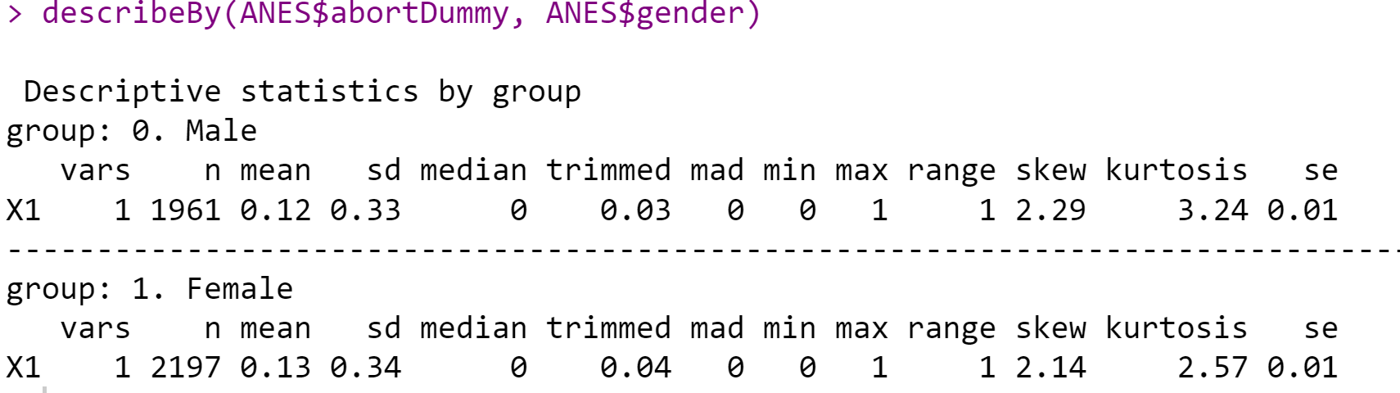
Create a Binary Variable from Categorical
attributes(tail(ANES$V161232))
table(ANES$V161232)
ANES$abortDummy <- recode(ANES$V161232, "1=1; 2=0;3=0;4=0; else=NA")
table(ANES$abortDummy)
describeBy(ANES$abortDummy, ANES$gender)

Slide 63
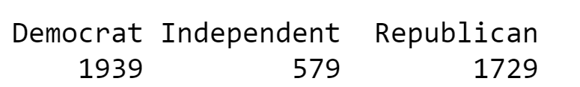
Consolidating a Variable’s Categories
ANES$partyid <- ANES$V161158x
ANES$partyid3 <- plyr::mapvalues(ANES$partyid, c(1,2,3,4,5,6,7), c('Democrat', 'Democrat', 'Democrat', 'Independent', 'Republican', 'Republican', 'Republican'))
table(ANES$partyid3)
table(ANES$V161158x)
0. DK; NA; other; refused to answer 968
1. Strong Democrat 9320
2. Weak Democrat 10390
3. Independent - Democrat 5649
4. Independent - Independent 5617
5. Independent - Republican 4772
6. Weak Republican 6790
7. Strong Republican 5592
Notes:
Always create a new variable – do not overwrite old variables (lost data – in your case backup on BB, but not always true).
Will create a new column in your data file – data view (and new row in variable view).
Always keep syntax so you know how you created new variables.

Slide 64
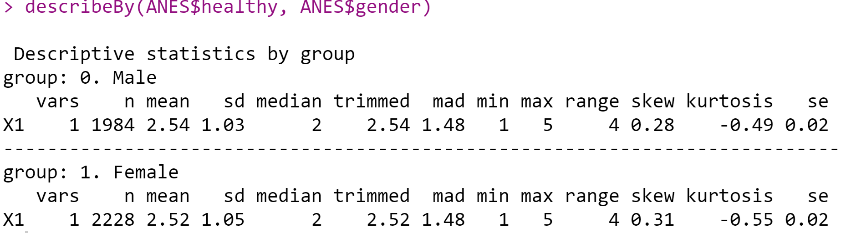
Comparing Groups so far….
describeBy reports descriptive statistics broken down by some categorizing variable (e.g., gender, age, etc.)

Slide 65
Comparing Groups so far….
> table(ANES$healthy, ANES$partyid3)
#Crosstabs of perception of health by party identification
> crosstabs <- xtabs(~healthy+partyid3, data=ANES) #useful for multiple variables
> summary(crosstabs)
partyid3
healthy Dem. Ind. Rep.
1 353 86 302
2 625 164 638
3 606 203 521
4 285 95 220
5 66 30 48
Notes:
Pg 174

Slide 66
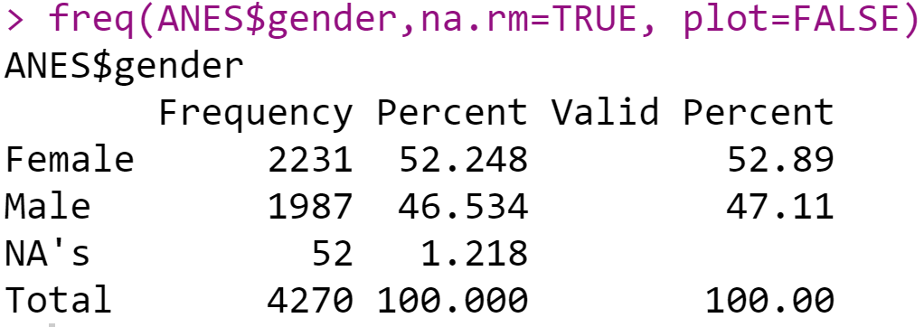
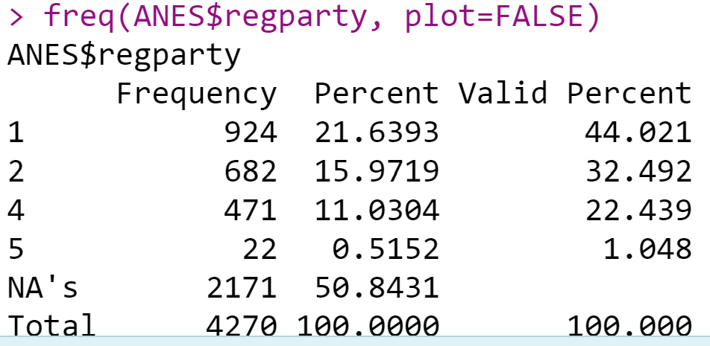
Frequencies with percentages
> freq(ANES$gender, na.rm=TRUE, plot=FALSE)
# women make up 52.25% of the respondents surveyed
Notes:
Pg 174

